Slide 1
CSE: 449 PARALLEL, DISTRIBUTED AND HIGH-PERFORMANCE COMPUTING
PAPER REVIEW PRESENTATION 2
Paper Title: Towards Edge-enabled Distributed Computing Framework for Heterogeneous Android-based Devices
Author: Yongtao Yao∗ , Bin Liu† , Yiwei Zhao† and Weisong Shi‡
Submitted by:
Name: Marzanul Momenine
ID: 22301194
Section: 01
Team: 26

Slide 2
Introduction
The vast improvements in computing technologies and the wide deployment of communication mechanisms the past decades have led to the widespread adoption of smart home edge devices .
Furthermore, Android is forecast to remain the most widely-used operating system for these smart home edge devices

Slide 3
Background and Related Work
Distributed machine learning (DML) algorithms were developed to aid the implementation of complex iterative neural networks.
Federated learning (FL) is a novel DML that is perfect to train models in a collaborative manner while preserving the privacy of sensitive data.
Berkeley Open Infrastructure for Network Computing (BOINC) is one of the leading distributed computing platforms used in a variety of fields.
BOINC provides clients for various operating systems, including the Android client, to allow volunteers to contribute their unused computing resources.
ThinkAir is a popular framework that makes it simple for developers to migrate their smartphone applications to the cloud.
ThinkAir exploits the concept of smartphone virtualization in the cloud and provides method-level computation offloading.
RAPID was proposed based on ThinkAir, which supports CPU and GPGPU computation offloading on Linux and Android devices.

Slide 4
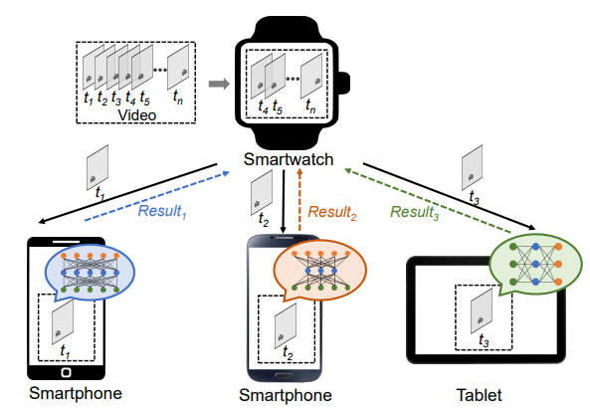
Methodology
Hardware Setup
Android Based edge devices, such as Smart Phone, Smart Watch etc
Dataset Selection
PDTV dataset
Model Selection
YOLOv3 and YOLOv3-Tiny
Framework Description
TensorFlow Lite

Slide 5
Design and Result Analysis
Stand Alone Learning
Distributed Computing Experiment

Slide 6
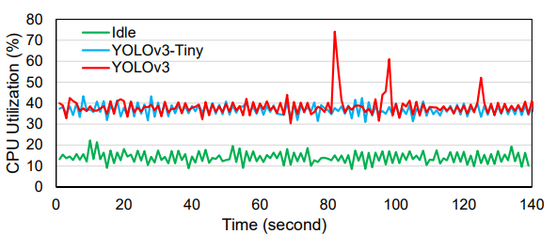
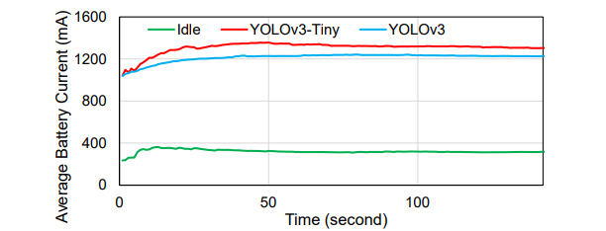
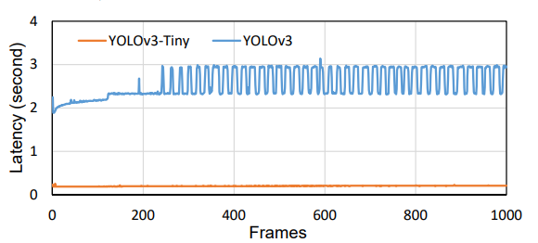
Stand Alone Learning

Slide 7
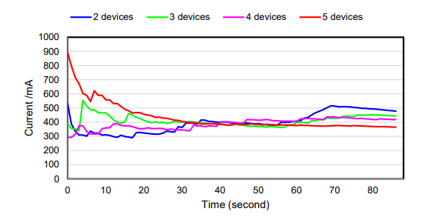
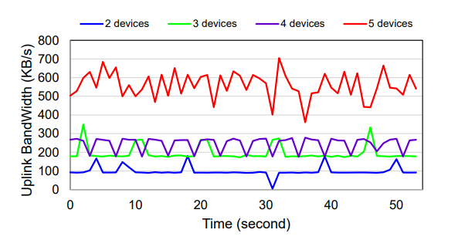
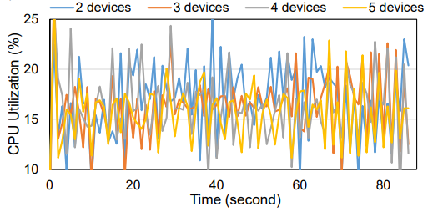
Distributed Computing Experiment

Slide 8
Conclusion
This paper proposes an Android distributed computing framework to accelerate edge DNN inference. The experimental results demonstrated that the proposed framework can reduce the CPU utilization by 24% and save 59.8% to 71.8% of the energy consumption. It is also demonstrated that the proposed framework will not lead to a high bandwidth footprint.

Slide 9
The END

